Slide 1
Laser Cutter Modifications
By: Jacob Albritton

Slide 2
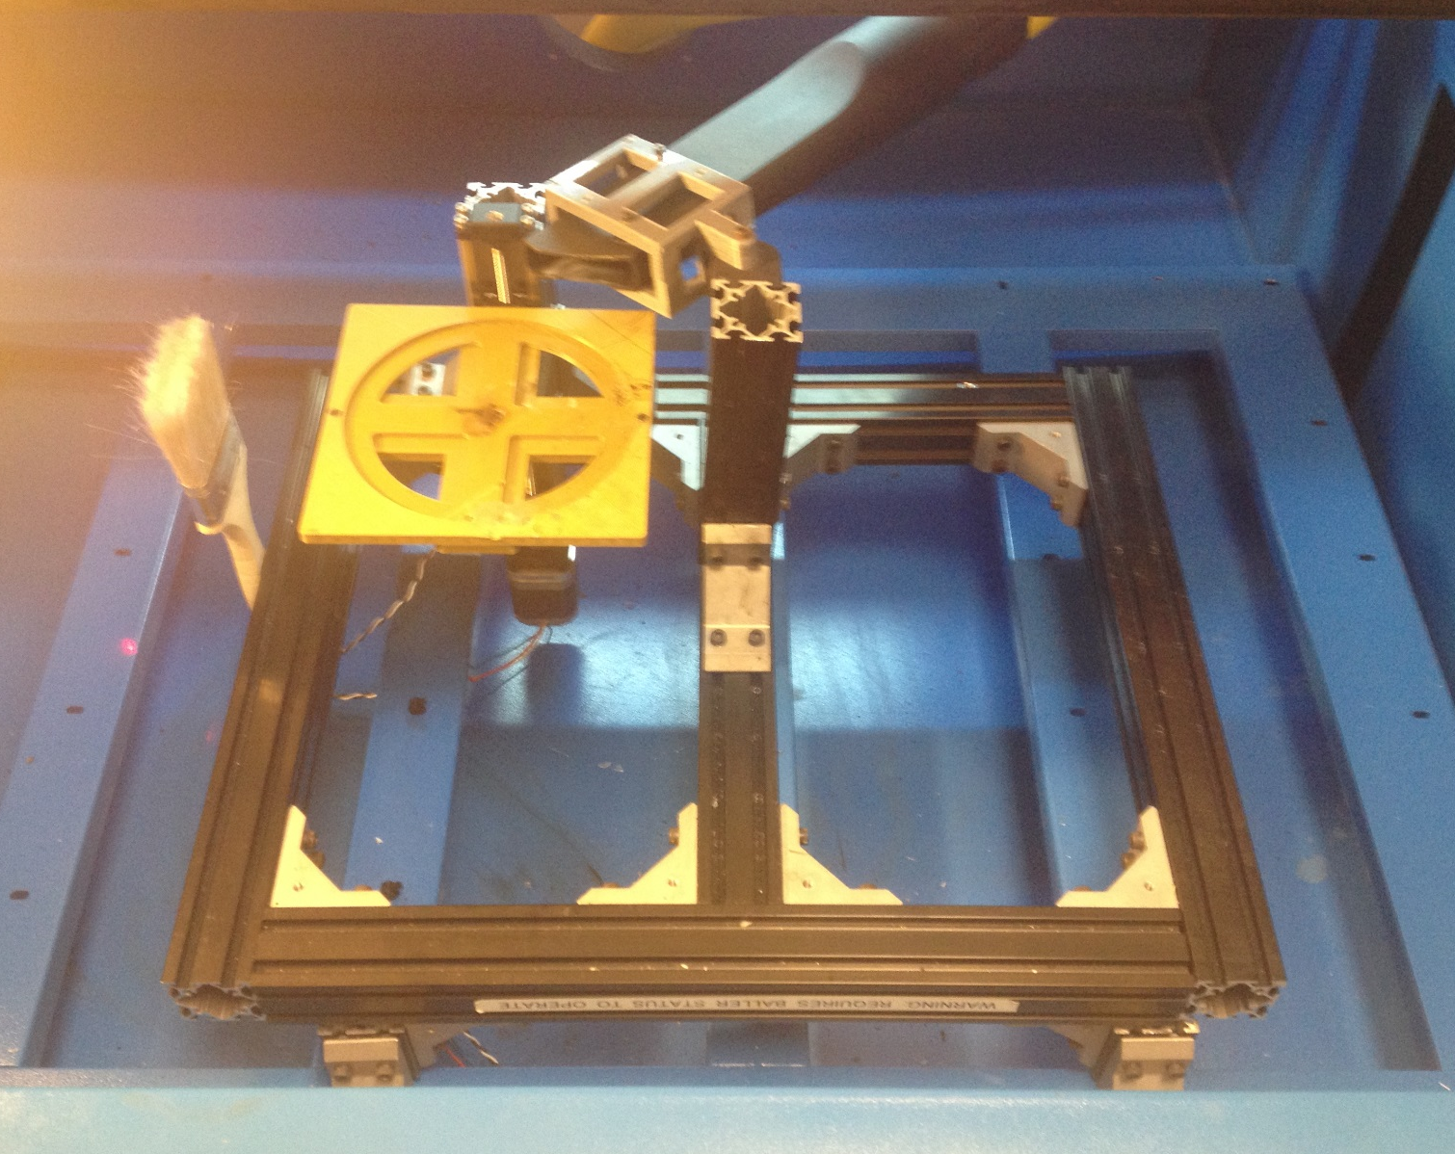
3D Printed Vacuum hose holder
Z-axis linear actuator
Laser Head Cleaning Brush
3D Printed platform
(Underneath the frame)
Z-axis motor
Frame Attachment to Laser Cutter

